Slide 1
AL SHIFA hospital
EXCELLENCE IN HEALTHCARE

Slide 2


Slide 3
Introduction
Al Shifa hospital provides outstanding healthcare and services for all.
Executive Health Program is part of Shifa International Hospital’s pursuance of excellence in healthcare. The Executive Health program is a thorough determination of your health status. The Health Check program assures you an experienced physician team of world-renowned specialists, cutting-edge technology, personal services and confidentiality.

Slide 4
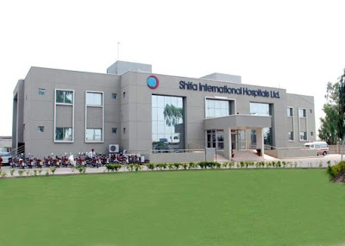

Slide 5
Vision and Mission
Health Care with Compassion for all.
To be the region’s leader by providing quality healthcare services.
Compassion, Commitment, Teamwork, Quality, Respect and Accountability

Slide 6
Our Strategic Priorities
Physician Partnership and Enhanced Clinical Quality
Provide Seamless/Easy Access Care Delivery
Strategic Growth
Financial Strength/Viability

Slide 7

Our services
1. Cancer Center
Shifa cancer center provides cure for cancer with both medical oncology and radiation oncology.

Slide 8
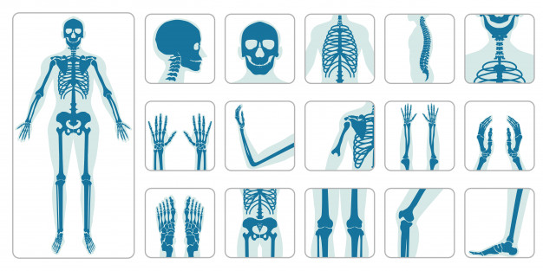
2. Orthopedics Center
The department of orthopedics has three surgeons, is a young and vibrant team trained in Ireland and UK. Two of the surgeons are on the Specialist Register in these countries.

Slide 9

3. Patient Portal
Patient Portal provides you facility to access your medical records, 24 hours per day, seven days a week.

Slide 10
General facilities
Telephone & Fax:
Rooms are equipped with telephones and you can easily make local calls by first dialing “9” and the number. For long distance, mobile phone calls or Fax service dial “0” and the hospital operator will assist you. The use of mobile phones is not permitted in ward areas as they can adversely affect the function of life support medical devices.
Internet Service:
Limited access is available to the patients in coordination with nurse in charge, PSD or admission office.
Television:
We also provide Color T.V. to help our patients, cope with the time in their diseased state for recreational activity but with a message to respect the right of their in-room fellow patients, if present.

Slide 11
Diagnostic services
Angiography
CT scan
Magnetic Resonance Imaging (MRI)
Mammography
Nuclear medicine
Radiology
Ultrasound

Slide 12
Patient facilitation department
Patients are our main concern, and we take pride in providing the best services to patients and visitors at Shifa International Hospital. Patient Facilitation Department (PFD) makes patients’ visit as comfortable and homely as possible. The department works on the following principles:
Motto
Patient Satisfaction
Health Care Packages PFD coordinates Executive Health Care Packages, which include:
General Health Package
Executive Physical Package
Cardiac Care Check up
Cancer Screening

Slide 13
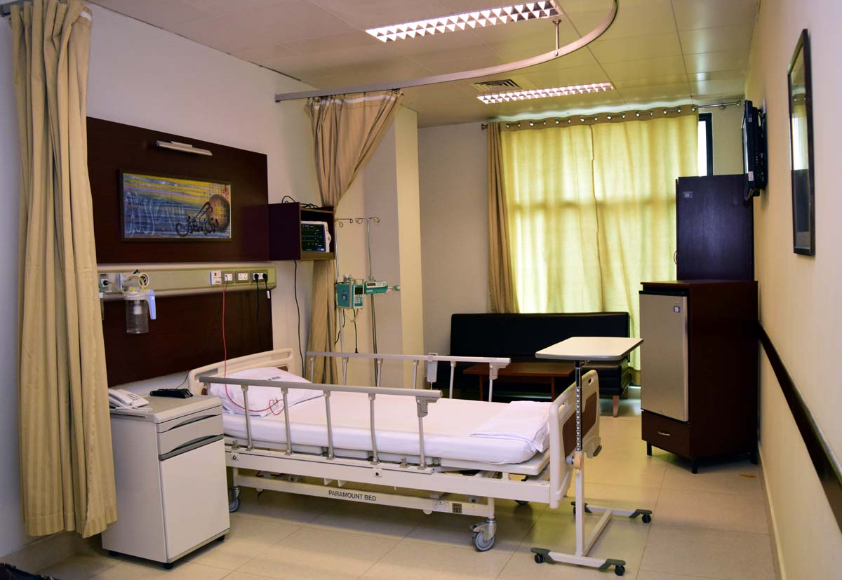
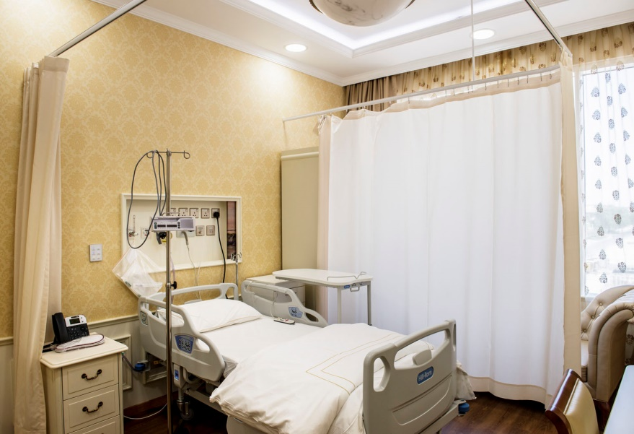
Night Duty Coverage
In order to extend coordination and support to the patients and night staff, a night duty officer on behalf of administration resolves queries and provides assistance when required.
Comfortable rooms
We provide comfortable and good patient services.

Slide 14
Other facilities
Implementation of Visitors Policy
Presence assured to attend trauma situations like Code Blue to pacify and calm down attendants.
Coordinating until dead body is handed over to attendants.
Coordinates for ambulance and provides assistance when required.
Providing wheel chairs and stretchers to patients when required
Online appointments

Slide 15
Contact us!
Phone # +92-51-846-3148, 846-3343, 846-3057 Fax: +92 051 4863182
Address: Pitras Bukhari Road, Sector H-8/4, Islamabad - Pakistan
Contact Details of the Person for Assisting and Handling Investor Grievances: Mr. Muhammad Naeem (Company Secretary) © 2019 Shifa International Hospitals Ltd., Islamabad Pakistan.

Slide 16
thankyou
….

